Slide 1

PhoneBelt is an app that helps parents track their teen’s driving and provides personalized driving suggestions

Slide 2
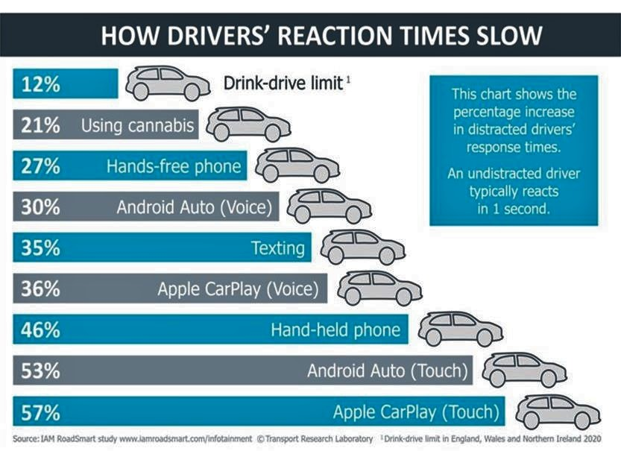

Slide 3


Slide 5
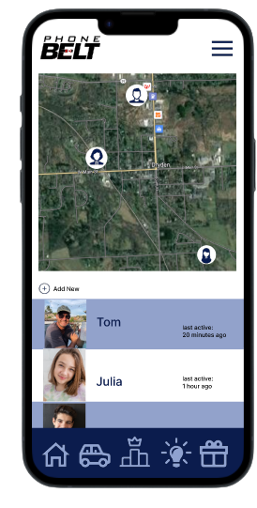
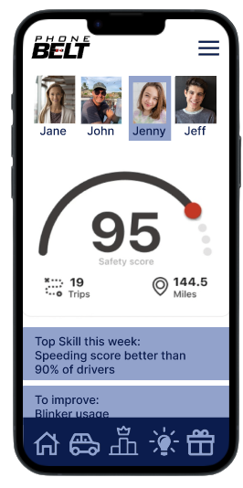
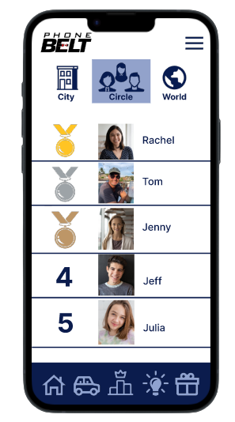
See Friends & Family
Get Drive Feedback
Gamify & Rewards

Slide 6










Slide 7
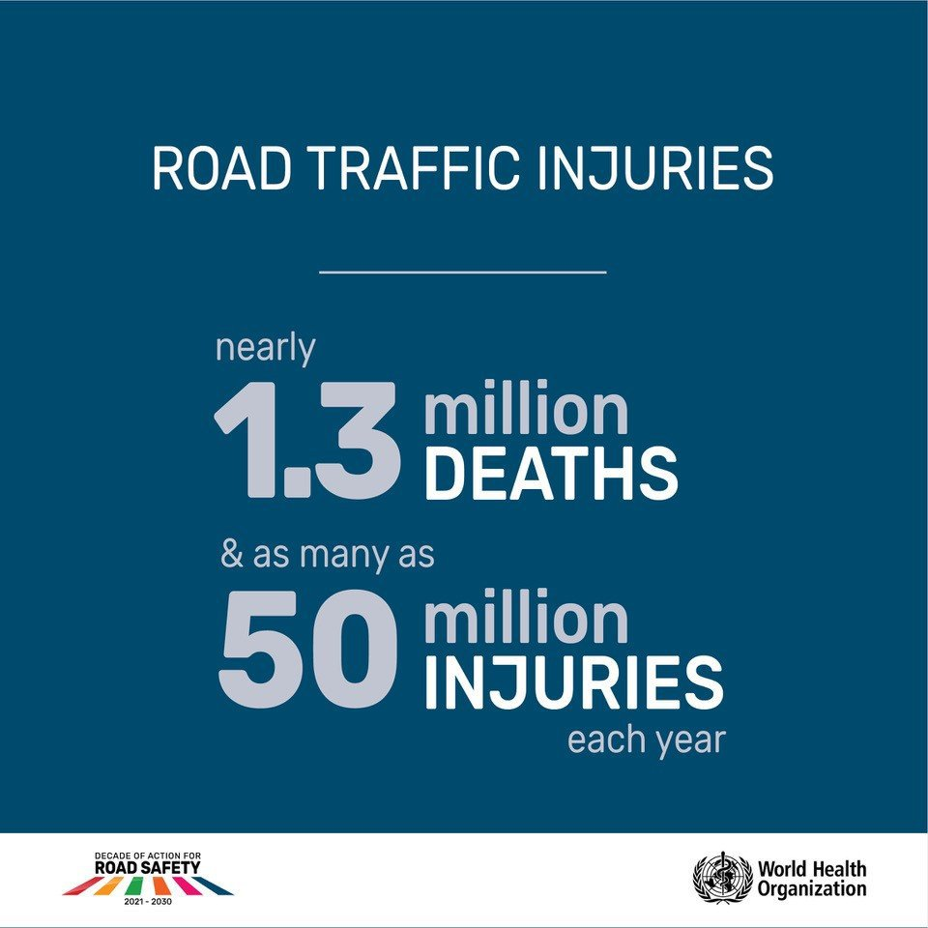
$2.5 Trillion in losses each year

Slide 8
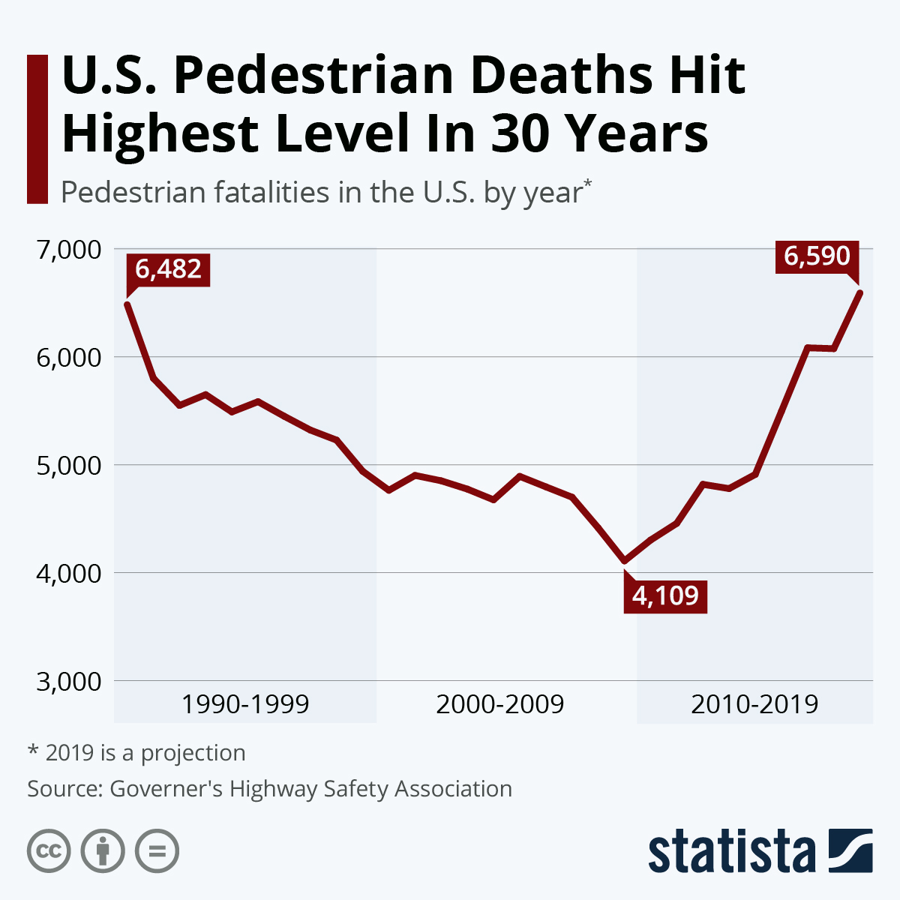

Slide 9
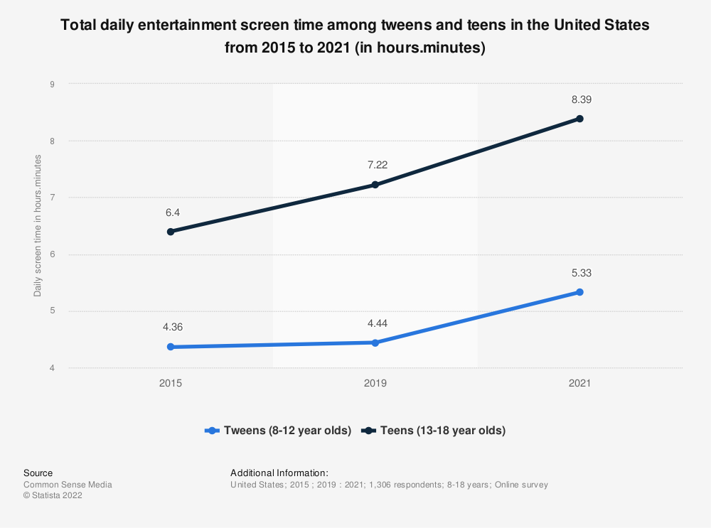

Slide 10
Phone Distractions While Driving
2000
2010
2020
Talking
Talking
Texting
Talking
Texting
Instagram
Snapchat
Spotify
Etc.

Slide 11
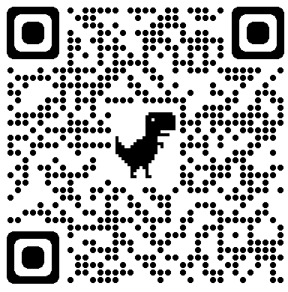
Thank You!
ThePhoneBelt.com
Contact me: Jamescscoleman@gmail.com

